Slide 1


Intro to Probability
DSML
Week 4

Slide 2
Table of Contents
Set theory
Inclusion-Exclusion Principle
Definition of Probability
Laplace's Rule
Intersection and Conditional Probability
Bayes theorem

Slide 3
Set Theory

Slide 4
Set Theory
Set is a collection of members or elements, and just like in Python, order doesn’t really matter. Furthermore, no repeated elements are allowed.
In mathematical notation, sets are often denoted by capital letters, and their elements are represented by lowercase letters. For example, if you have a set containing the elements 1, 2, and 3, it might be denoted as follows:
A = {1, 2, 3}
If we want to say that an element belongs to a set, we often use the following notation:
x ∈ A (in this example 1 ∈ A)
On the other hand, if an element does not belongs to a set, we write:
x ∉ A (in this example 4 ∉ A)

Slide 5
More on Set Theory
Two sets are said to be equal if they share the same elements
If A = {1, 2, 3, 4, 5} and B = {3, 1, 2, 5, 4} we can say set A and set B are equal
Set-builder notation provides a concise way to define sets based on certain conditions. For example:
B = { x : 0 < x < 10}, is read as "The set B is defined as the set of all x such that 0<x<10”.
So if we have A = {1, 3, 5, 7, 9} and B = { x : 0<x<10 and x is odd} we can say A = B, because because both sets consist of the same elements, namely {1, 3, 5, 7, 9}.

Slide 6
More on Set Theory
Some definitions
A is a subset of B if all elements of A are also elements of B. For example:
Let A = {1, 2, 3, 4, 5} and B = {x: 0 <x <10}, we can say A is a subset of B.
Null/Empty set is a set with no elements, denoted as C={}.
Two sets are said to be mutually exclusive/disjoint if they have no element in common. For example:
Let A = {1,2,3} and B = {0, 10, 20} are said to be mutually exclusive/disjoint.

Slide 7
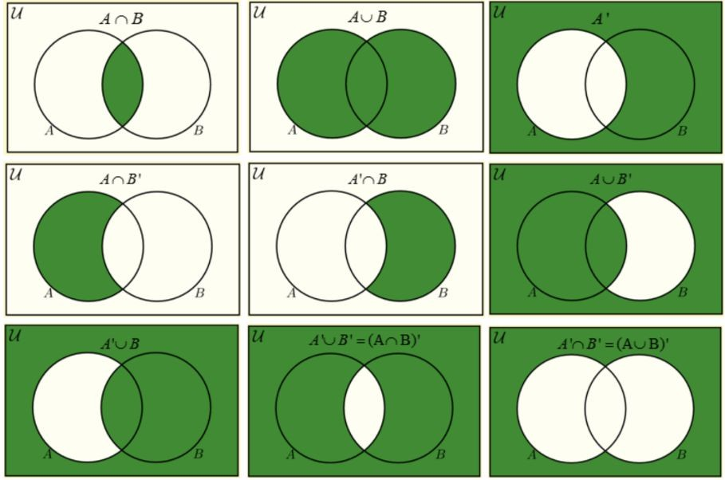
Union, Intersection, Complement

Slide 8
Inclusion-Exclusion Principle
The Inclusion-Exclusion Principle is a counting technique used to find the size of the union of multiple sets. It accounts for the overlap between sets, ensuring that elements are not double-counted. The general formula for two sets A and B is:
|A ∪ B| = |A| + |B| - |A∩B|
And for three sets A, B and C the formula extends as:
|A ∪ B ∪ C| = |A| + |B| + |C| - |A∩B| - |A∩C| - |B∩C| + |A ∩ B ∩ C|

Slide 9
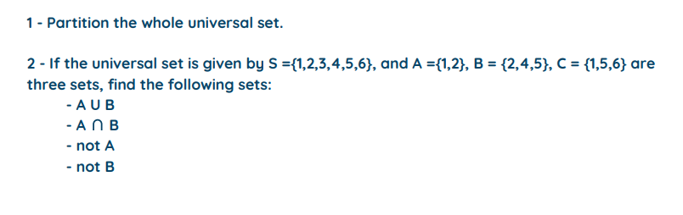

EXERCISE

Slide 10

From Sets to Probability
Some definitions
Sets and Probability are linked through the conceptual and mathematical framework provided by set theory, which probability theory builds upon to quantify uncertainty and analyze random phenomena.
Sample Space: In probability theory, a sample space is the set of all possible outcomes of a random experiment. For example, if you are rolling a six-sided die, the sample space would be
{1, 2, 3, 4, 5, 6}

Slide 11
Probability
Events: An event is a subset of the sample space, representing a specific outcome or a combination of outcomes. Events can range from simple events (single outcomes) to compound events (multiple outcomes). For instance, in the die example, the event of rolling an
even number is {2, 4, 6}
Note:
P(Sample Space) = 1 P(A) >= 0
How can we calculate the likelihood of rolling an even number? Laplace’s Rule

Slide 12
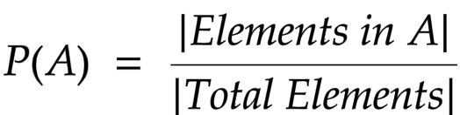
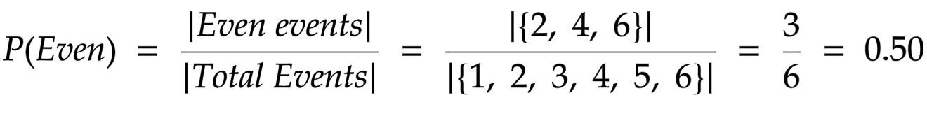
Probability - Laplace’s Rule
Laplace's Rule requires equally likely and finite outcomes in a sample space. Coming back to die example, we can calculate the likelihood of obtaining an even number by the following expression:
In this case:

Slide 13
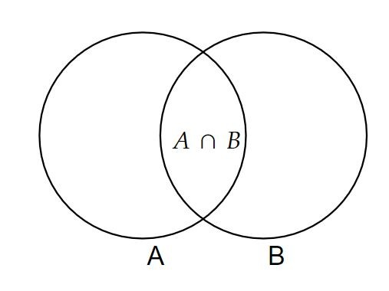

Intersection Probability
Intersection probability explores the likelihood of simultaneous occurrence of two or more events; for example, drawing a card that is both a face card and black from a standard deck.
Consider set A to be the set of all the Face Cards
and set B the set of all Black Cards.

Slide 14

Intersection Probability
By definition we have:
In this case:
This is is only valid if even A does not influence the likelihood of B happening, this is, if A and B are independent events.

Slide 15
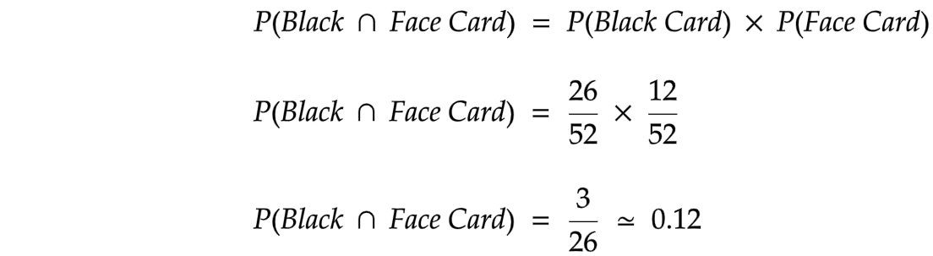
Intersection Probability
Finally we get:

Slide 16




Intersection Probability
What happens if A and B are dependent events? In that case we have:
or

Slide 17


Conditional Probability
Conditional probability measures the likelihood of an event occurring given another event has already occurred.
Probability of A given that B has already happened.

Slide 18

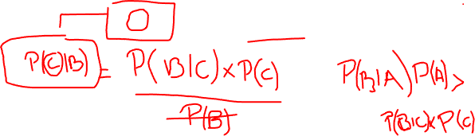
Bayes Theorem
(guys, this is the first glimpse of Machine Learning you have in this course)
Bayes Theorem is a fundamental concept in probability theory that relates conditional probability to marginal probabilities (probability of individual events happening). The formula for Bayes Theorem is as follows:
Marginal Probabilities

Slide 19
Independence , Dependence, Implicit
Independence -> Dependence -> Implicit

Slide 20
Independence , Dependence, Implicit
Independence -> Dependence -> Implicit
INDEPENDENCE: Color and type of card
DEPENDENCE: Genetics and Height
IMPLICIT: I stand in the rain, I get wet

